Slide 1
HV mini-project seminar
High Voltage engineering course
Giustino – Cormac – Ying – Saioa – Pablo - Nicola
31st October, 2012

Slide 2
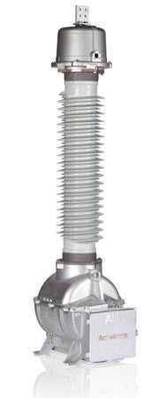
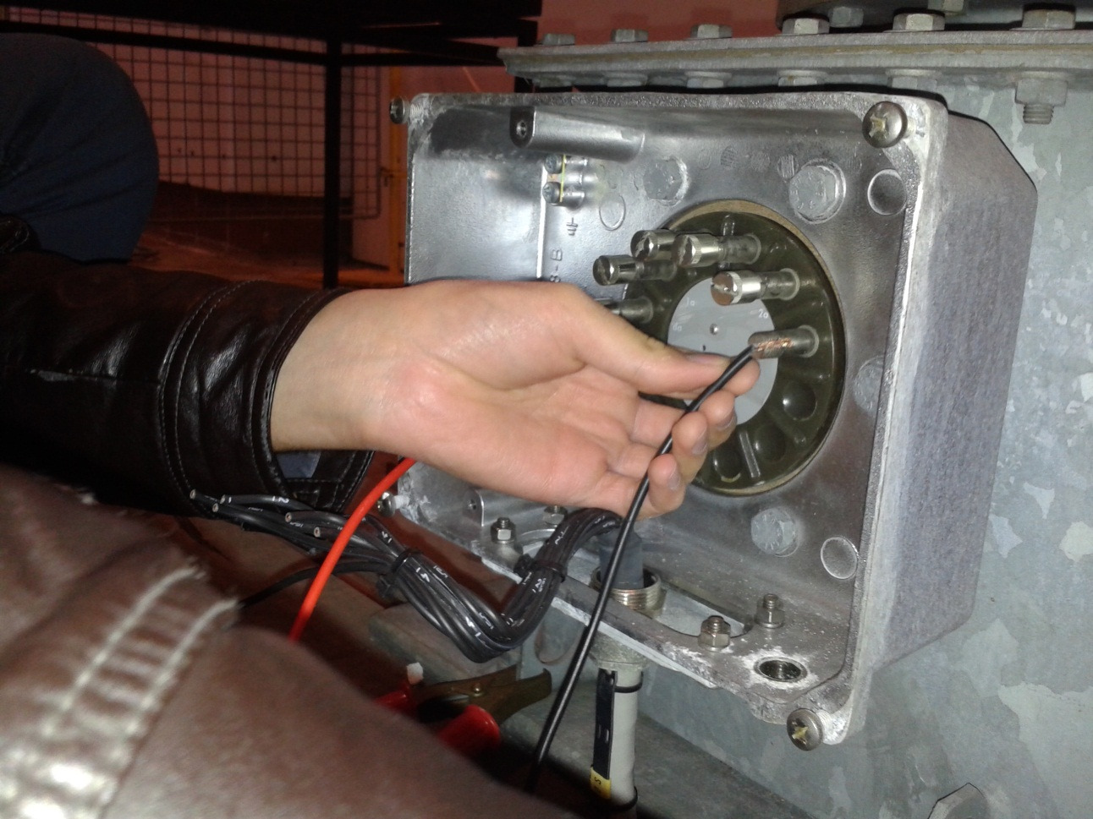
Description of voltage transformer
ABB EMF 72 Transformer

Slide 3
Description of voltage transformer
Rated data
Voltage Tranformer | ABB EMF 72
Insulation Level 140-350 kV | High Volt. for equipment 72 kV 50 Hz
Standard IEC 186 | Voltage factor (Vf) 1.9/8h
Total mass 190 kg | Year of manufacture 1998
A-N | 1a-1n | 2a-2n | da-dn
60000V / √3 | 110V / √3 | 110V / √3 | 110V / √3
Load | 1 – 15 VA | 1 – 65 VA | 75 VA
Class | 0,2 | 0,2 | 3P

Slide 4

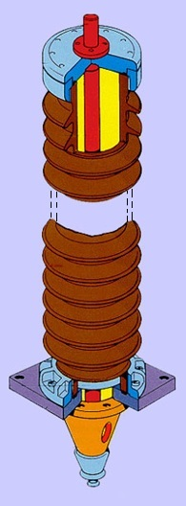
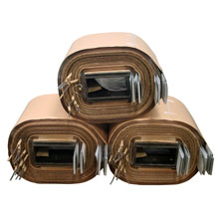
Description of voltage transformer
Conductor
Oil+Paper
SF6
Porcelain Bushing Insulators
Internal Insulator
External Insulator

Slide 5
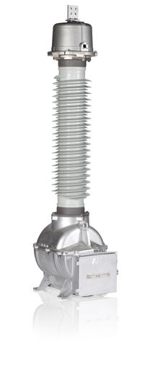
Transfer Ratio
The primary winding of the transformer is connected directly to the high voltage source transformer via aluminium conductors
Output voltage measured at secondary winding of transformer using a multimeter

Slide 6
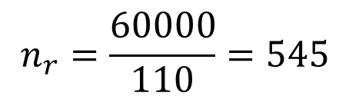

Transfer Ratio
Ideal transformer
Rated transfer ratio
Transfer Ratio
$$\frac{V_{p}}{V_{s}}=\frac{N_{p}}{N_{s}}=n$$
$$n_{r}=\frac{60000}{110}=545$$

Slide 7
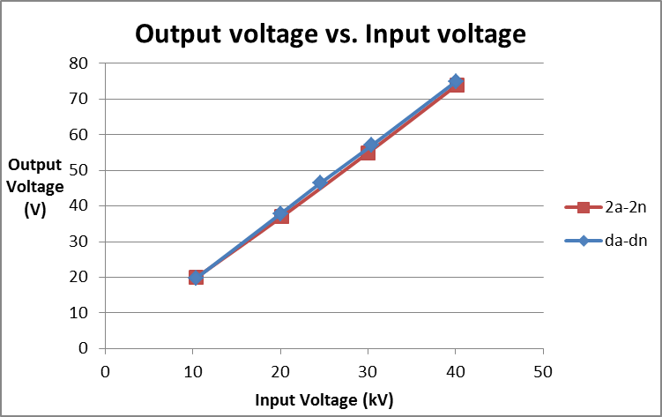
Transfer Ratio

Slide 8
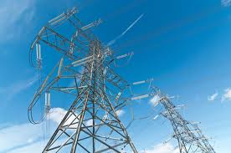
Lightning Overvoltage Test
What’s Lightning overvoltage?
Originated by lightning stroke on the phase wires of overhead line or busbars
Caused by switching phenomena

Slide 9
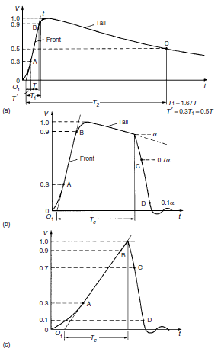
Lightning Overvoltage Test
Waveforms of Lightning Impulse
Figure 1 General shapes and definitions of lightning impulse (LI)
(a)Full LI (b) LI chopped on the tail (c)LI chopped on the front.
T₁: front time T₂: time to half-value T_{c}: time to chop o₁: virtual origin

Slide 10
Lightning Overvoltage Test
What should be done in the test?
Build a circuit that can generate lightning impulses and be able to control their waveforms.
Apply the generated lightning impulses to the insulation part of the transformer and test how much it can undertake.
Connect the surge arrester to the insulation and test it.

Slide 11
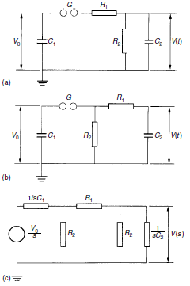





Lightning Overvoltage Test
Impulse voltage generator circuits
$$V\left(s\right)=\frac{V_{o}}{k}\frac{1}{s^{2}+as+b}$$
$$a=(\frac{1}{R_{1}C_{1}}+\frac{1}{R_{1}C_{2}}+\frac{1}{R_{2}C_{2}})$$
$$b=\frac{1}{R_{1}{R_{2}C}_{1}C_{2}}$$
$$k=R_{1}C_{2}$$
$$V\left(t\right)=\frac{V_{o}}{k}\frac{1}{(α_{2}−α_{1})}[exp\left(−α_{1}t\right)−\exp{(−α_{2}t)}]$$

Slide 12
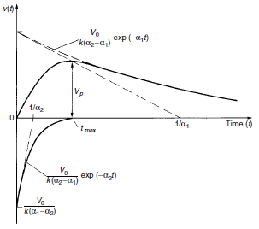
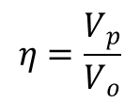
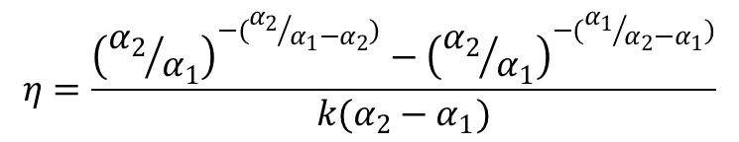
Lightning Overvoltage Test
Impulse voltage generator circuits
$$η=\frac{V_{p}}{V_{o}}$$
$$η=\frac{{\left({α_{2}}/{α_{1}}\right)}^{−({α_{2}}/{α_{1}−α_{2}})}−{\left({α_{2}}/{α_{1}}\right)}^{−({α_{1}}/{α_{2}−α_{1}})}}{k(α_{2}−α_{1})}$$

Slide 13
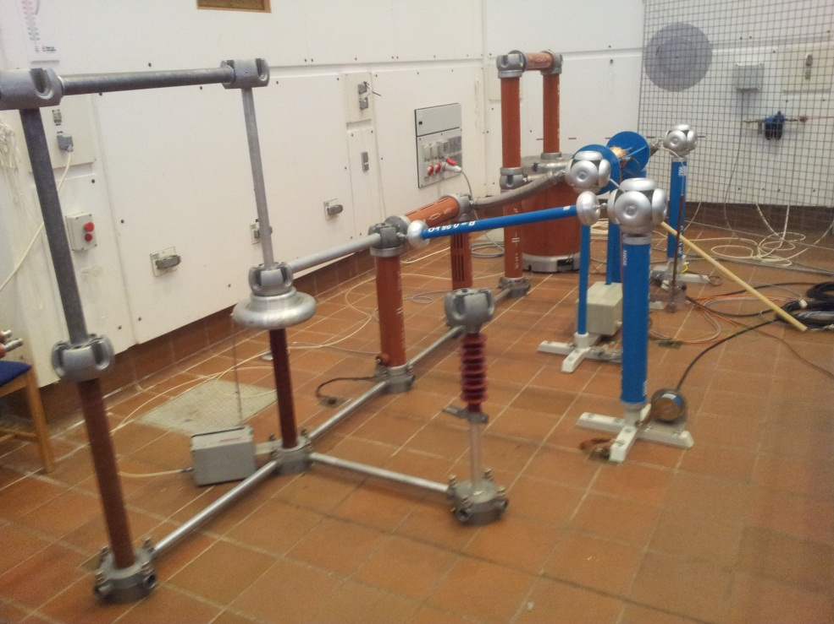
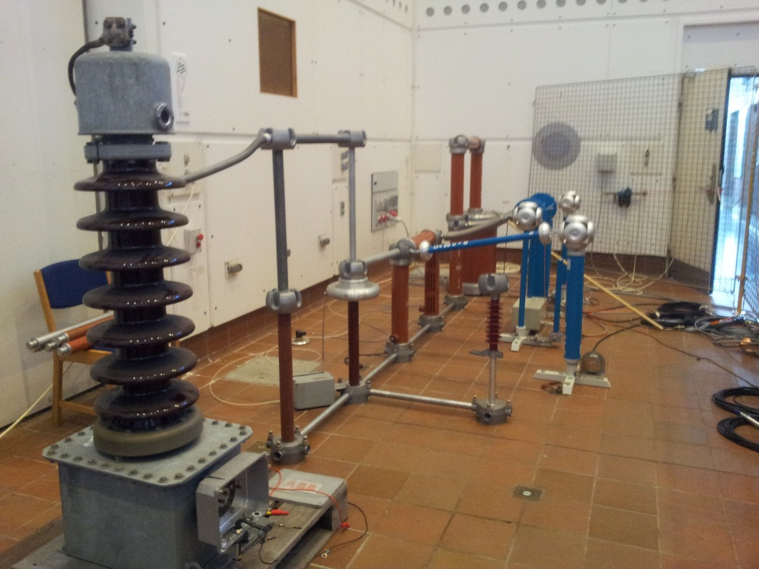
Lightning Overvoltage Test
Experiment Setup

Slide 14
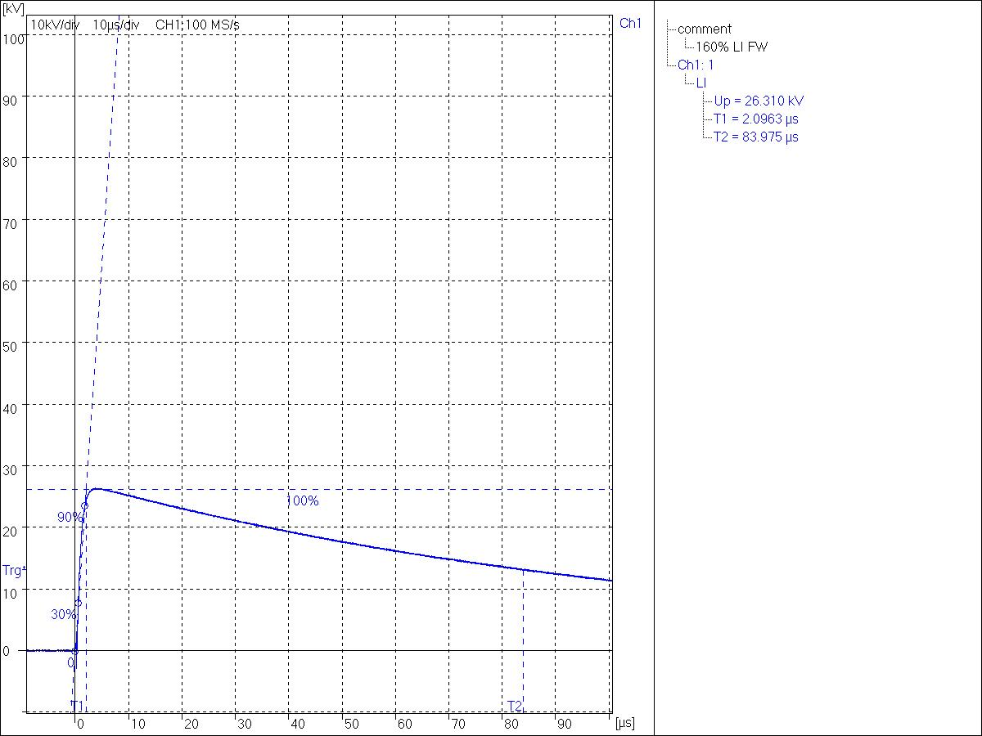

Lightning Overvoltage Test
Experimental Results
$$V_{o}=30kv, η=0.877$$

Slide 15
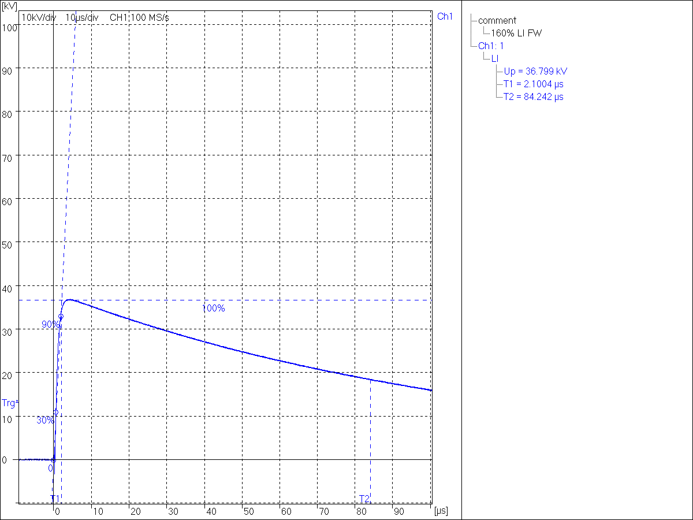

Lightning Overvoltage Test
Experimental Results
$$V_{o}=42kv, η=0.876$$

Slide 16
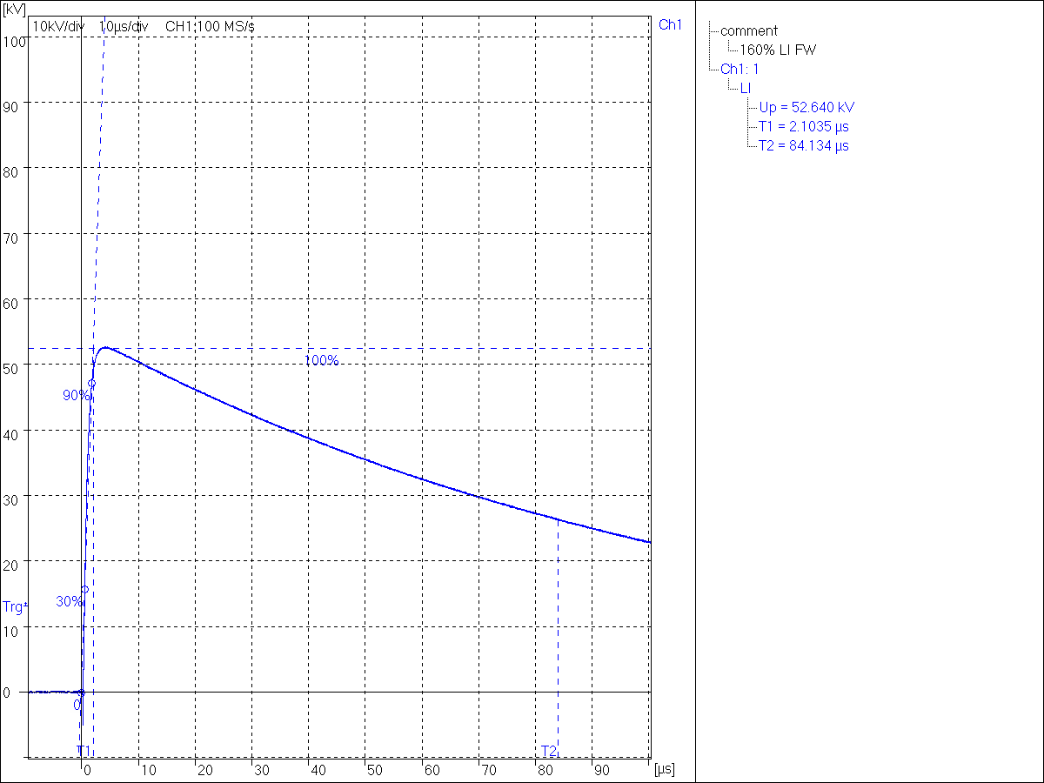

Lightning Overvoltage Test
Experimental Results
$$V_{o}=60kv, η=0.877$$

Slide 17
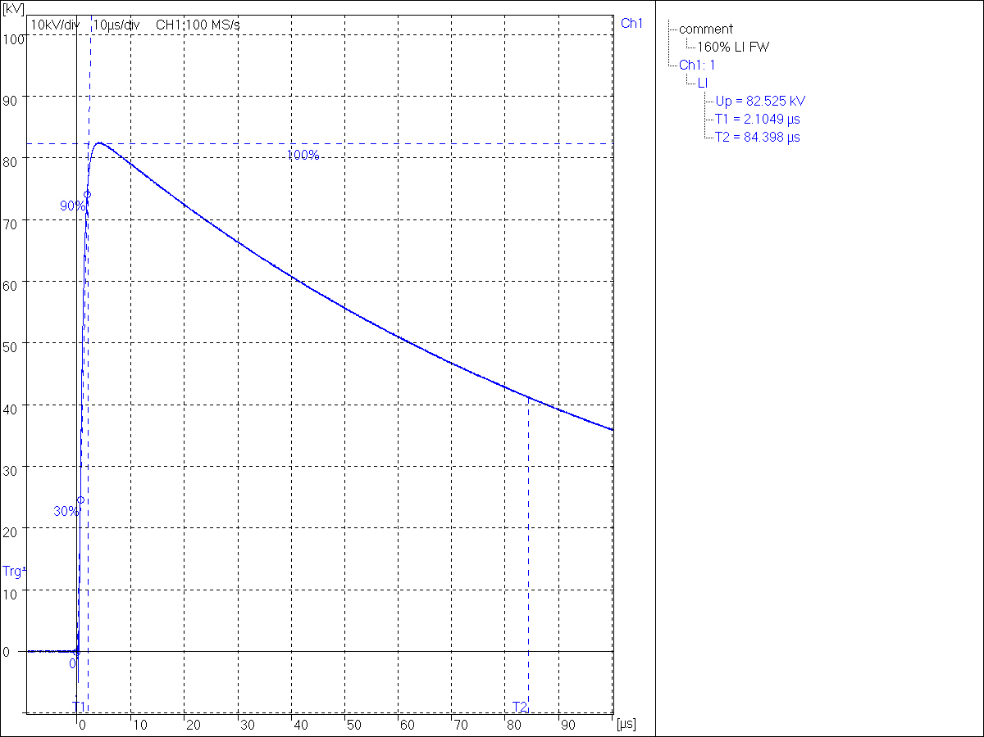

Lightning Overvoltage Test
Experimental Results
$$V_{o}=90kv, η=0.868$$

Slide 18
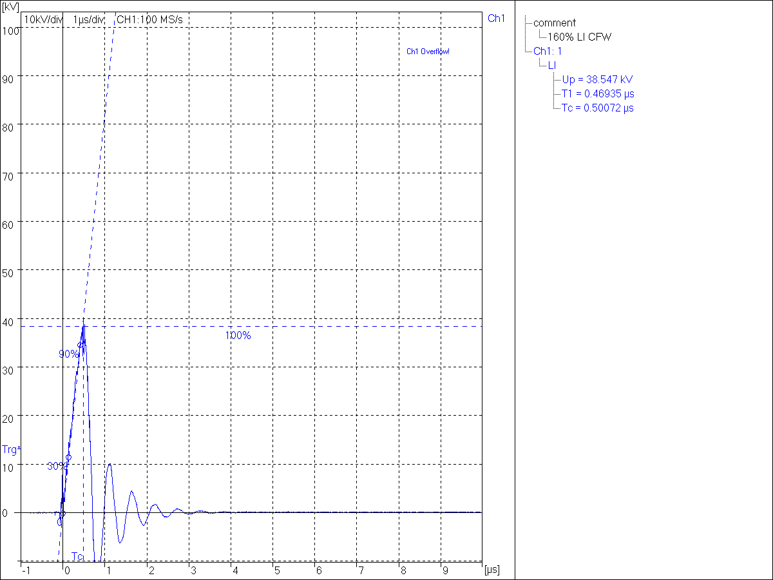

Lightning Overvoltage Test
Experimental Results
$$V_{o}=85kv, insulation grounded$$

Slide 19
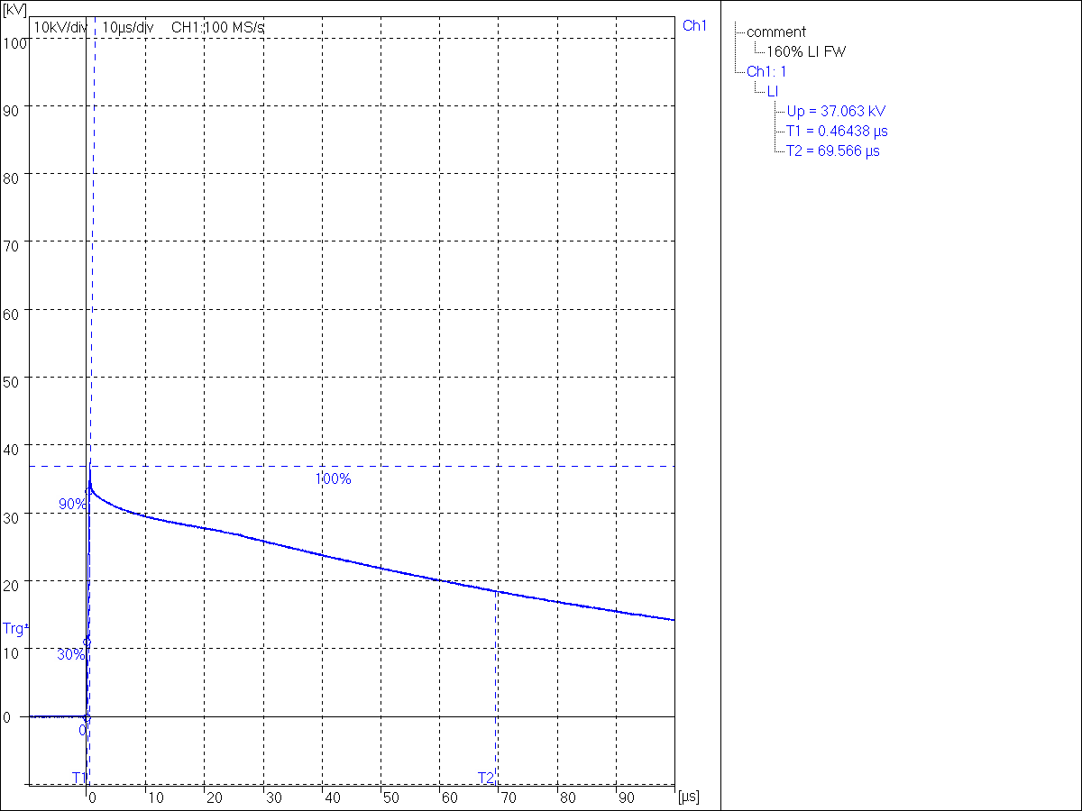

Lightning Overvoltage Test
Experimental Results
$$V_{o}=85kv, surge arrester$$

Slide 20
Dielectric Loss Angle Measurement
What is it?
Non destructive High-Voltage isolation test.
Why is it measured?
Dielectrics and isolating materials can be characterized by its natural polarization phenomena.
How can it be determined?
In the Frequency domain it can be model as a capacitance [C] and a power dissipation magnitud quantified with the loss factor [tan δ].

Slide 21
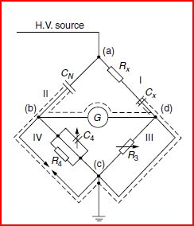
LAB SET-UP
Dielectric Loss Angle Measurement
Theoreticaly
Schering Bridge
Measure of C and tan δ by comparing with Cn
Cn: gas-filled capacitor with very low loss
Frequency for which the system has been designed
In the lab
Transformer used in previous exeriments
.
Frequency: 50Hz

Slide 22
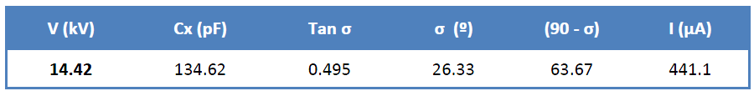
Dielectric Loss Angle Measurement
1st Measure: Measuring the primary of the transformer.
The capacitance and the loss angle are bigger than expected.
NOT VALID MEASURE

Slide 23
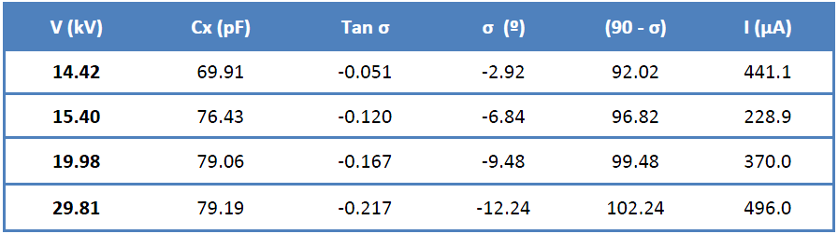
Dielectric Loss Angle Measurement
2nd Measure: Measuring the secondary.

Slide 24
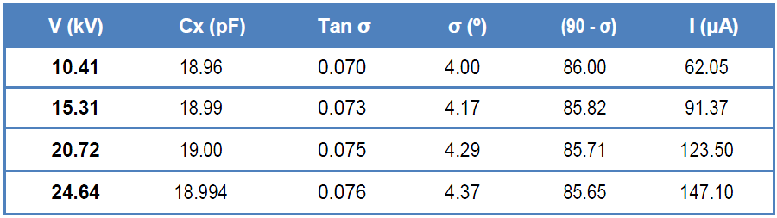
Dielectric Loss Angle Measurement
3rd Measure: Adding a home made Capacitor
The maximum voltage that the capacitor can handle: 25kV.

Slide 25
Partial discharges measurement
What is a partial discharge?
Partial discharges (PD) can be defined as discharges only partially short circuiting an insulating media between two electrodes with different potential.
Why do we measure partial discharges?
It has a significant effect on the life of insulation. Every discharge event causes a deterioration of the material by energy impact.

Slide 26
Partial discharges measurement
Types of Partial Discharges (PD):
External Partial Discharges
Corona: type of PD in gaseous media (audible noise)
Surface discharges: PD in boundaries between different dielectrics (i.e. gas/oil)
Internal Partial Discharges
PD in cavities in solid or liquid dielectrics

Slide 27
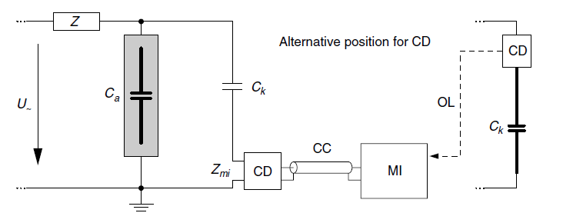
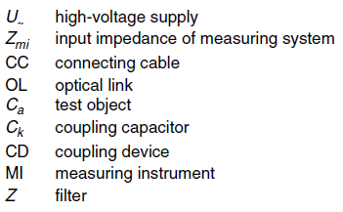
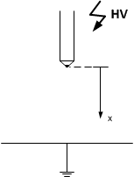
Partial discharges measurement
Laboratory setup
At the moment when the PD appears, the sharpen part will be HV side

Slide 28
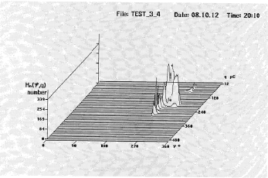

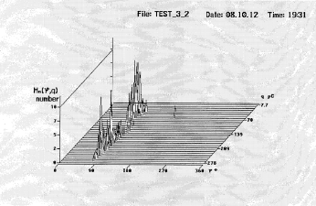
Partial discharges measurement
Experimental results (HQQ 3-D plot)
External partial discharges:
Corona effect or surface discharges
They occur:
At the peaks of the Voltage waveform (90 or 270º)
A->K (90º) / K->A (270º)

Slide 29
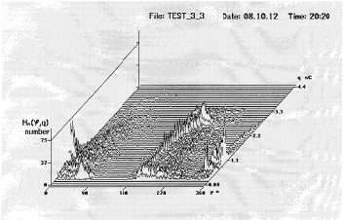
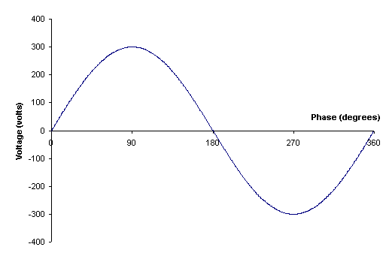
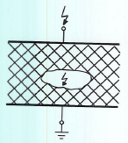
Partial discharges measurement
Experimental results (HQQ 3-D plot)
They occur:
At 0 / 180 / 360º
External PD
Internal PD
Internal partial discharges:
In voids or cavities

Slide 30
Dielectric spectroscopy test
- Spectroscopy is the measurement of the parameters in the frequency of isolation
- The perfect isolation has a 90°

Slide 31
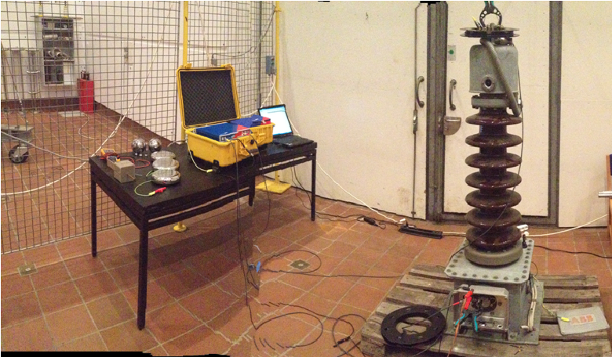
LABORATORY SETUP

Slide 32
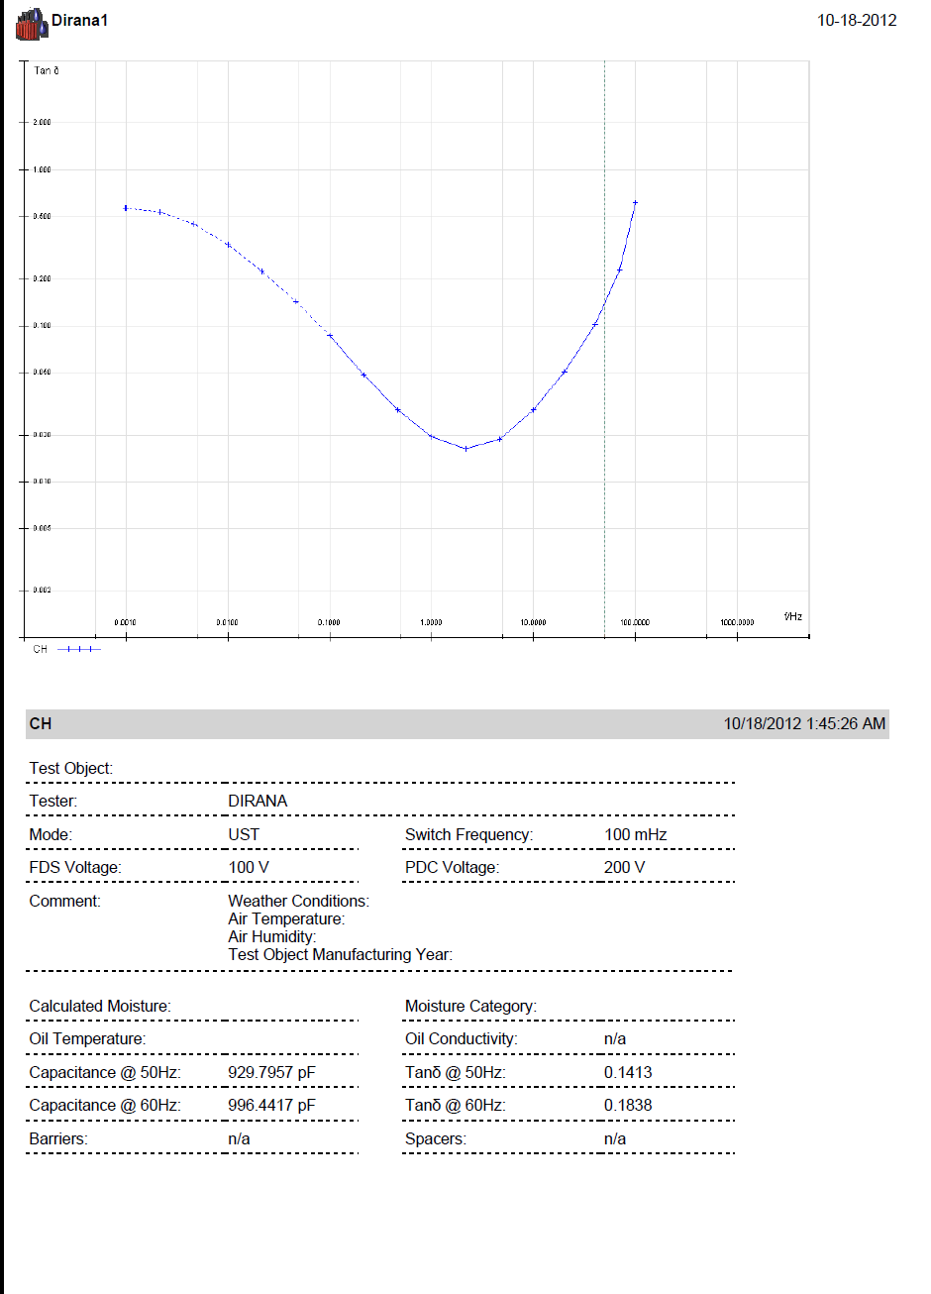
RESULTS

Slide 33
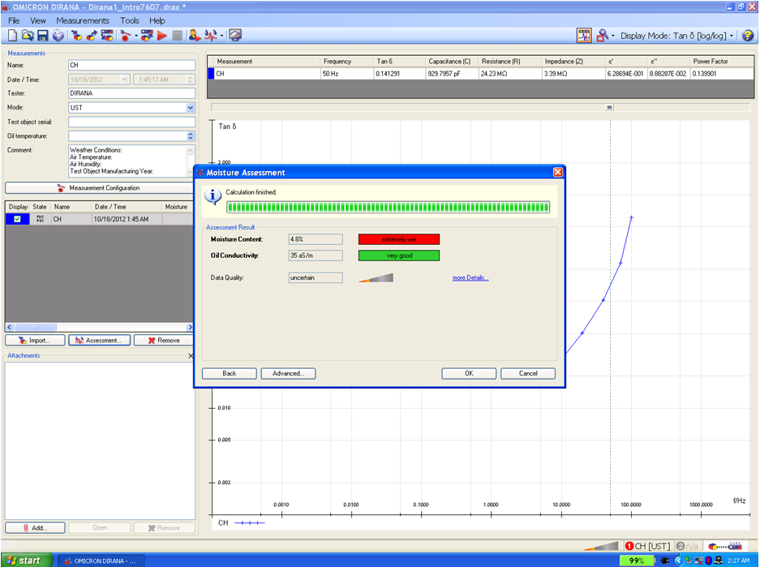
RESULTS
Moisture content: 4,8 %
Oil conductivity: 35 aS/m

Slide 34
Partial discharges measurement
References
[1] E. Kuffel, W.S.Zaengl and J. Kuffel, High Voltage Engineering: Fundamentals,second edition 2000, Newnes, ISBN 0 7506 3634 3.
Lectures and laboratory notes. High voltage engineering course. Aalborg University.

Slide 35
Partial discharges measurement
Thanks for
your attention!

